Slide 1
Autokey Cipher
Dr. Abhijit Sen

Slide 2
Autokey Cipher
An Autokey cipher is identical to the Vigenère cipher with the exception that instead of creating a keyword by repeating one word over and over, the keyword is constructed by appending the keyword to the beginning of the actual plaintext message.
For example, if your plain text message was: This is a secret message And your keyword was "zebra", then your actual keyword would be: Zebrathisisasecretmessage
Enciphering and deciphering the message is performed using the exact same method as theVigenère cipher

Slide 3
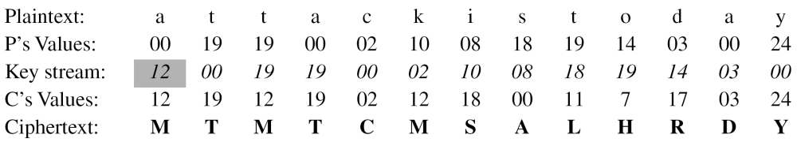
Assume that Alice and Bob agreed to use an autokey cipher with initial key value k₁ = 12. Now Alice wants to send Bob the message “Attack is today”. Enciphering is done character by character.

Slide 4
Autokey Cipher
For other variations see: http://www.purplehell.com/riddletools/autokey.htm
http://realmoftwelve.kryptos.info/toolbox/autokey.html

